Slide 1

The e-Justice Portal and the interconnection of land registers – state of play
Dick Heimans
Deputy Head of Unit B2 – DG JUST

Slide 2
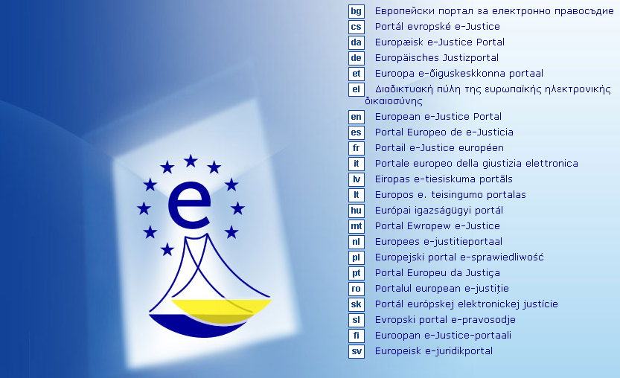
Introduction

Slide 3
European e-Justice
Use of ICT at the service of judicial systems
Simplify procedures
Improve access to justice
Reduce costs

Slide 4
The European e-Justice Portal aims at…
Being a one stop shop for justice matters
Interconnecting existing national justice applications
Re-using and linking to existing information
Serving diverse stakeholders at EU level

Slide 5
But does not aim at…
Replacing existing national solutions
Centralising more than necessary
Replacing or modifying existing offline procedures and practices

Slide 6
General Philosophy
Single point for Justice e-Services
Step by step approach
Multilingual from day one
Decentralised as much as possible

Slide 7
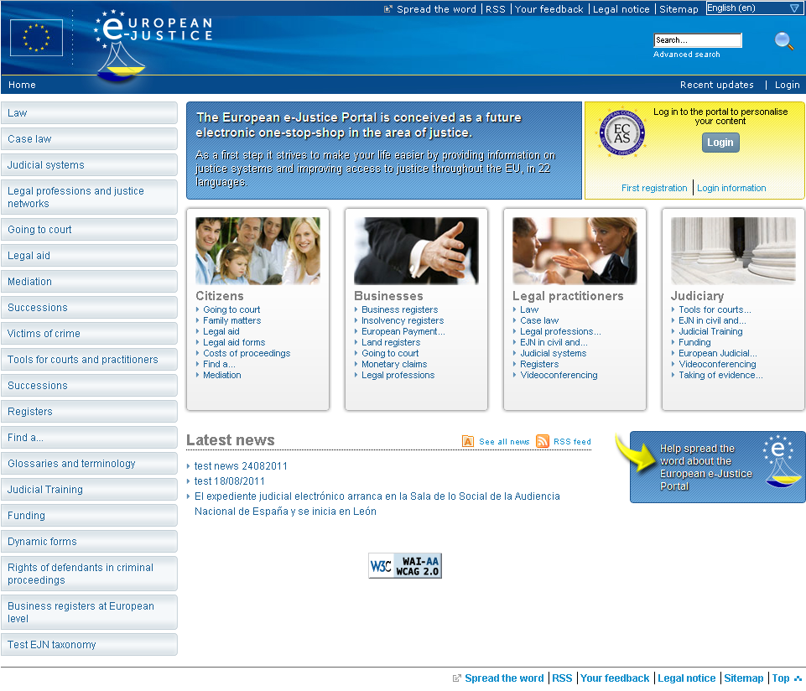

Slide 8
Facts and figures
  1,388,100 visits in the last two years from more than 200 countries
  Approximately 80,000 visits per month – increasing trend
  As of April 2012 about 15,000 pages of content in 22 of the official EU languages
  More than 2,000 forms being generated from the Portal per month

Slide 9
Interconnection Projects
Insolvency Registers
Find a Lawyer
Find a Notary
European Case Law Identifier (ECLI)
Business Registers
Registers of Translators/Interpreters
Land Registers

Slide 10
Challenges
Data protection
Interoperability
Translation
Different national approaches
E-Authentication, e-Identification

Slide 11
Land Registers Interconnection
Included in Action Plan
EULIS exists already
Need to incorporate all MS
Different approaches in different MS
Access issues in some MS
Financial issues

Slide 12
Land Registers Interconnection
Discussion Document – 3 models, proposal for feasibility study – February e-Justice Working Party
E-Justice Working Party agreed to have a feasibility study
Terms of Reference discussed in May Working Party
Contractor selected in September
Contract will start 1 November

Slide 13
Land Registers Interconnection Model 1
e-Justice Portal develops its own solution for interconnection

Slide 14
Land Registers Interconnection Model 2
e-Justice Portal interconnects the EULIS portal and Member State registers

Slide 15
Land Registers Interconnection Model 3
e-Justice Portal integrates and extends the EULIS platform

Slide 16
Feasibility Study – expected results
Transparent and fair comparison of the 3 models – legal, technical, financial aspects
Horizontal approach to payment
Discussion document for e-Justice Working Party
Basis for further development, if so decided
Timing: April/May 2014

Slide 17
Thanks for your attention!
https://e-justice.europa.eu
JUST-E-JUSTICE@ec.europa.eu

