Slide 1


October 2021

Slide 2
Conceptualization and formalization techniques FACTSHEETS integration in the IMOLA I.KOS - methodology and practical vision
October 2021

Slide 3
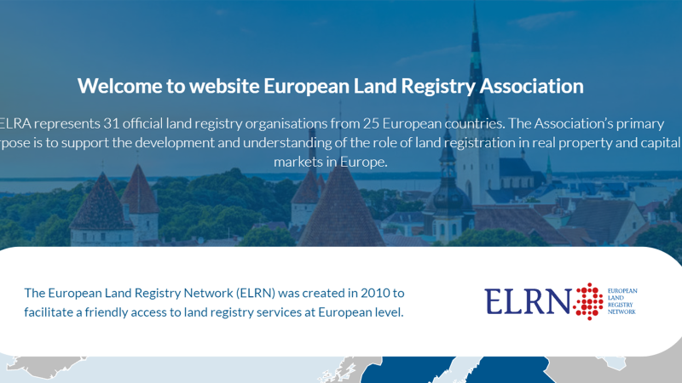

Slide 4
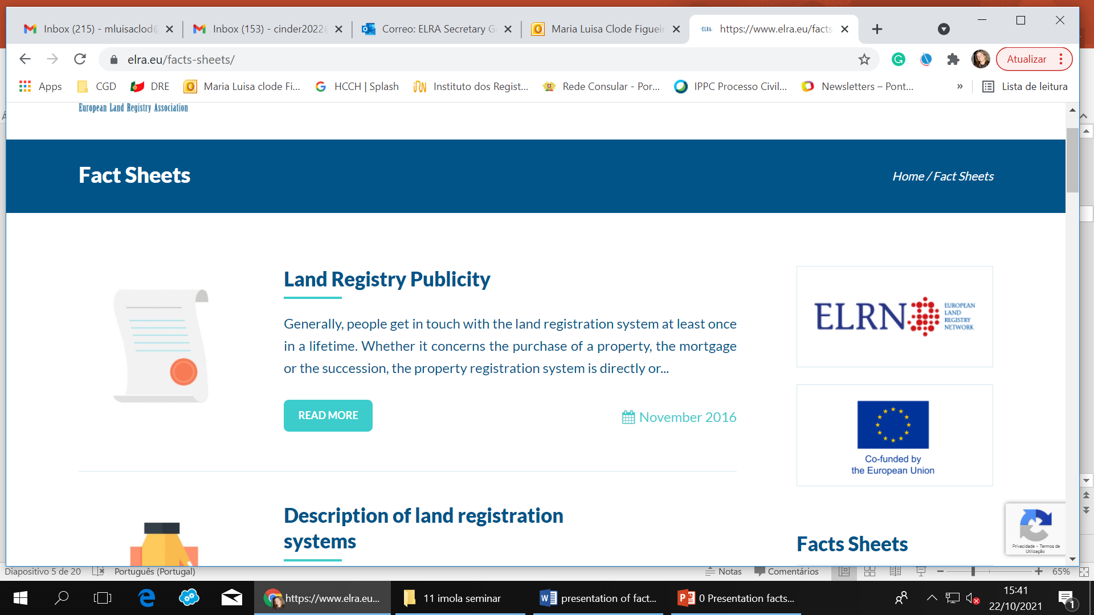

Slide 5
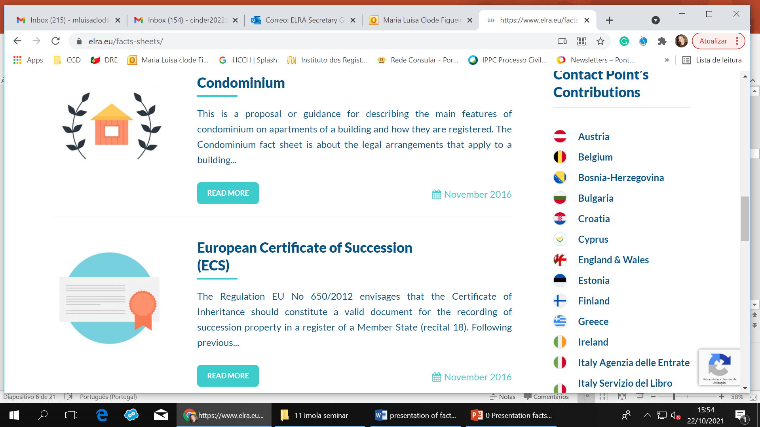

Slide 6
1. Factsheet itself finding all the questions and answers as regards that topic.
2. Country perspective finding all the work develop by that MS as regards all the fact -sheets.

Slide 8
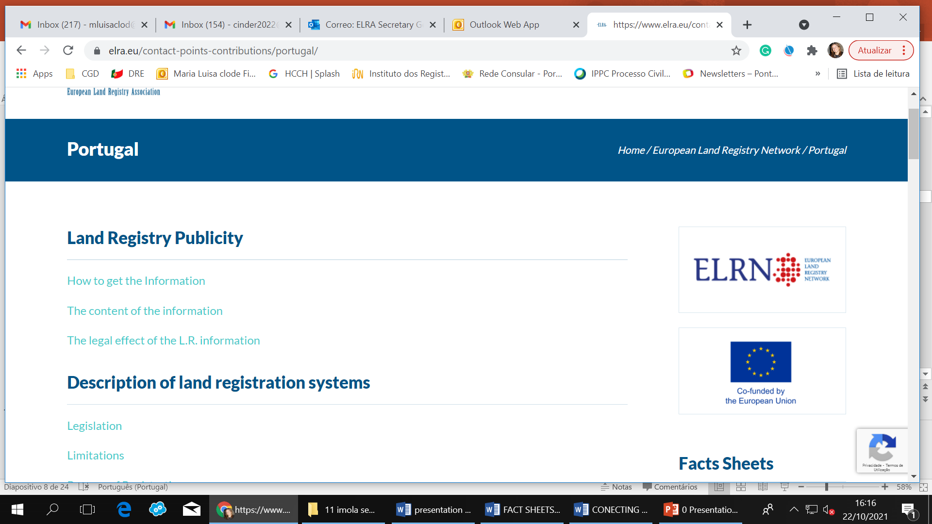

Slide 9
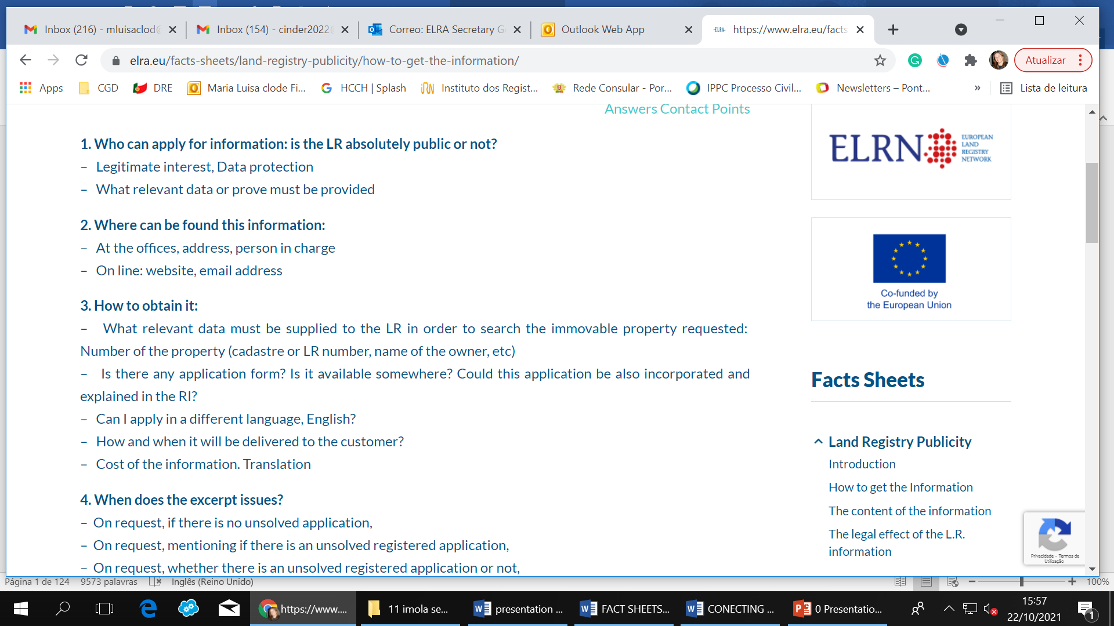

Slide 10
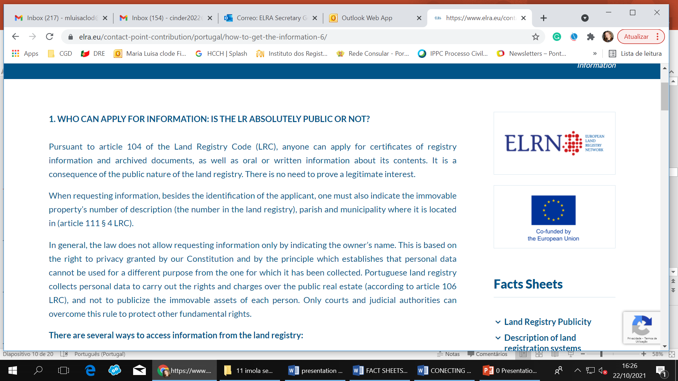

Slide 11



FACT SHEETS CONCEPTUALIZATION AND FORMALIZATION: LAND REGISTRY PUBLICITY
FS BLOCK | QUESTION | FS TERM | FS SYNONYM | FS RELATED | ELRD PART | ELRD PIVOT | SYNONYM | RELATED
How to get Land Registry Information | Who can apply for LR information | Applicant | Requester | Legitimate Interest Register Application | Front Page |  |  | » Legal person » Natural person » Person entitled

Slide 12

We had a good move and went for a better one!

Slide 13
FACT SHEETS CONCEPTUALIZATION AND FORMALIZATION: LAND REGISTRY PUBLICITY
QUESTION | ANSWER | FACT-SHEET | ELRD PIVOT | SYNONYM | RELATED
How to get LR information: Application Who can apply for LR information? | Text extracted from national factsheet and updated when necessary | Land Registry Publicity | ELRD | European Land Registry Document | Applicant Authentication of applicant Requester Excerpt Legitimate interest Register Application

Slide 14
FACT SHEETS CONCEPTUALIZATION AND FORMALIZATION: LAND REGISTRY PUBLICITY
QUESTION | ANSWER | FACT-SHEET | ELRD PIVOT | SYNONYM | RELATED
How to get LR information: Application Who can apply for LR information? | Anyone can apply for certificates of registry information and archived documents, as well as oral or written information about its contents. It is a consequence of the public nature of the land registry. There is no need to prove a legitimate interest. | Land Registry Publicity | ELRD | European Land Registry Document | Applicant Authentication of applicant Requester Excerpt Legitimate interest Register Application

Slide 15
Update the national answers in the factsheet
Reusing ELRN information for Imola purposes, consolidating synonyms and relationships suitable.

Slide 16
Thank you for your attention and collaboration!!
Luisa Clode
Secretary General
secretary.general@elra.eu
October 2021

