Slide 1
Data Interoperability and Digital Transformations
Introducing the new Digital Europe Programme
Peter Burian – DG Informatics

Slide 2
Evolving EU Policy Framework
Evolving EU Policy Framework
Data – Open Data, Data Governance, Data Spaces
Cybersecurity – Cyber Act, NIS2
Identity and Trust – eIDAS, blockchain
Single Digital Gateway
Smart Cities and Communities, Health, Green Transition, …
EU Funding – Digital Europe Programme, Recovery and Resilience Fund …
Berlin Declaration
Interoperability Policy
… “strengthening Europe’s digital sovereignty and interoperability” …

Slide 3
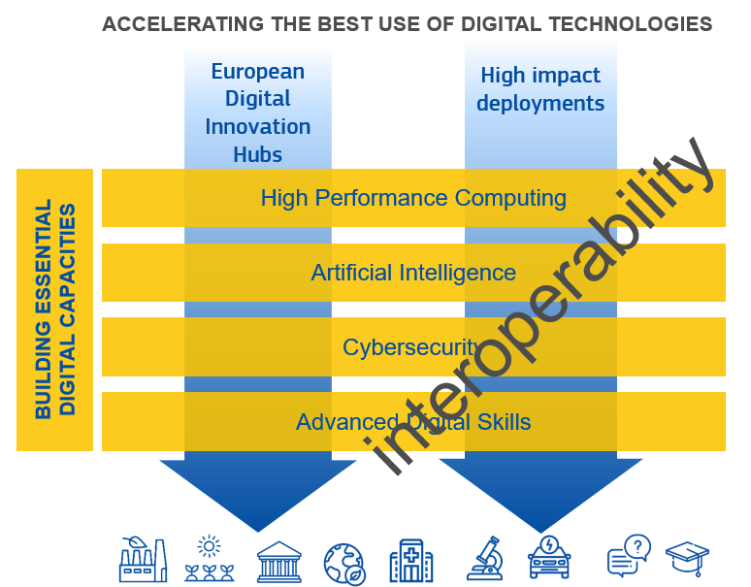
ISA2 to DEP – Introducing the Digital Europe Programme

Slide 4
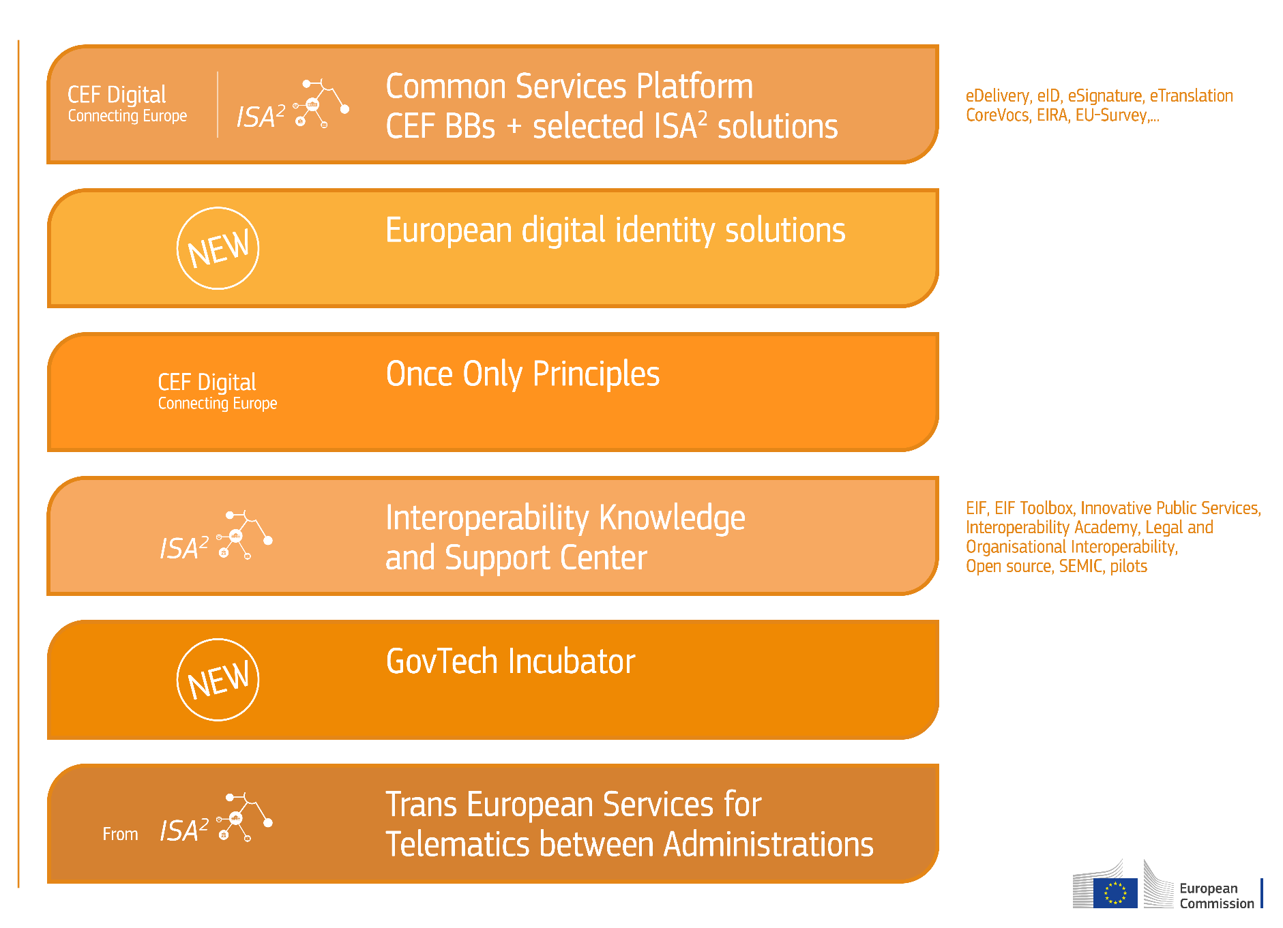
European Digital Government EcoSystem
Focus on Digital Government

Slide 5
“Data is the new currency.” “Data is the new oil.” “In God we trust, all others must bring data.”
Various quotes floating around the internet show how important data is for the current age.

Slide 7
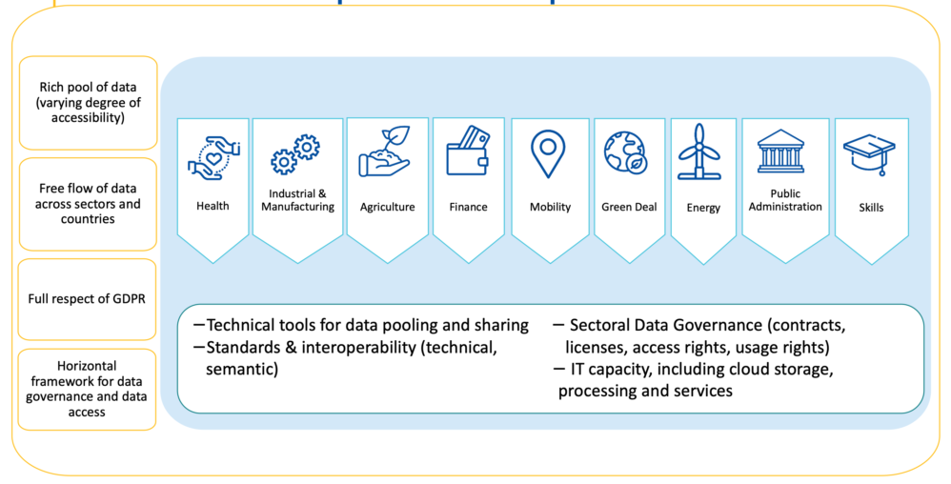
Common European Data Spaces

Slide 8
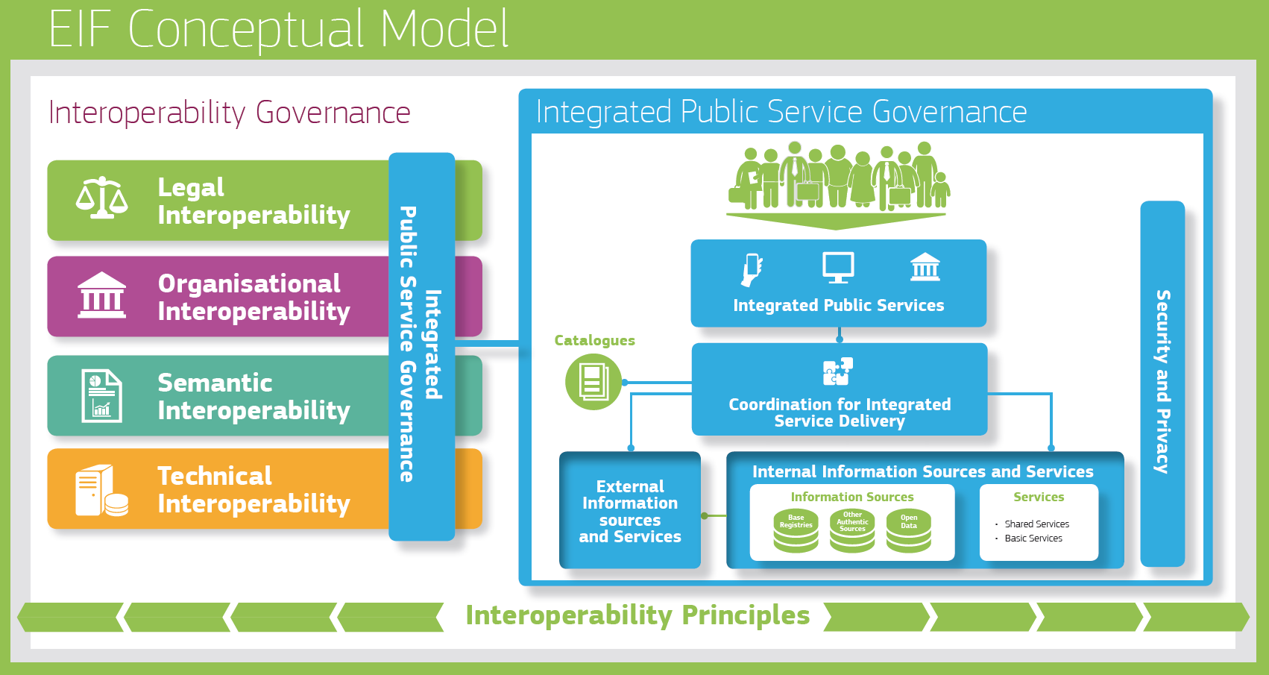
Interoperability and European Public Services

Slide 9
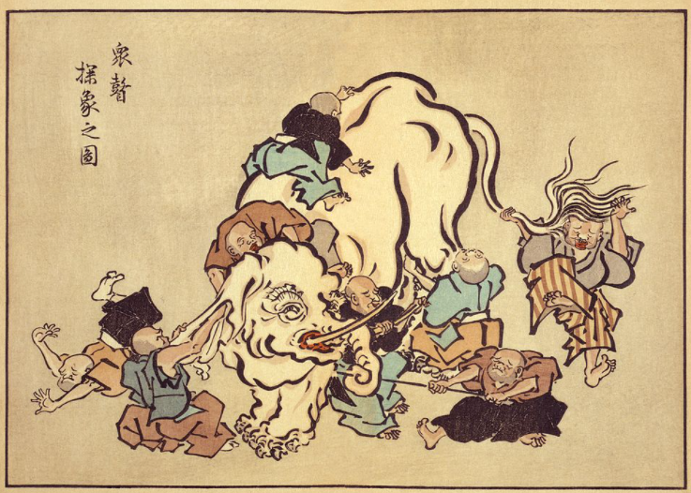
Semantic interoperability is about common meaning.

Slide 11
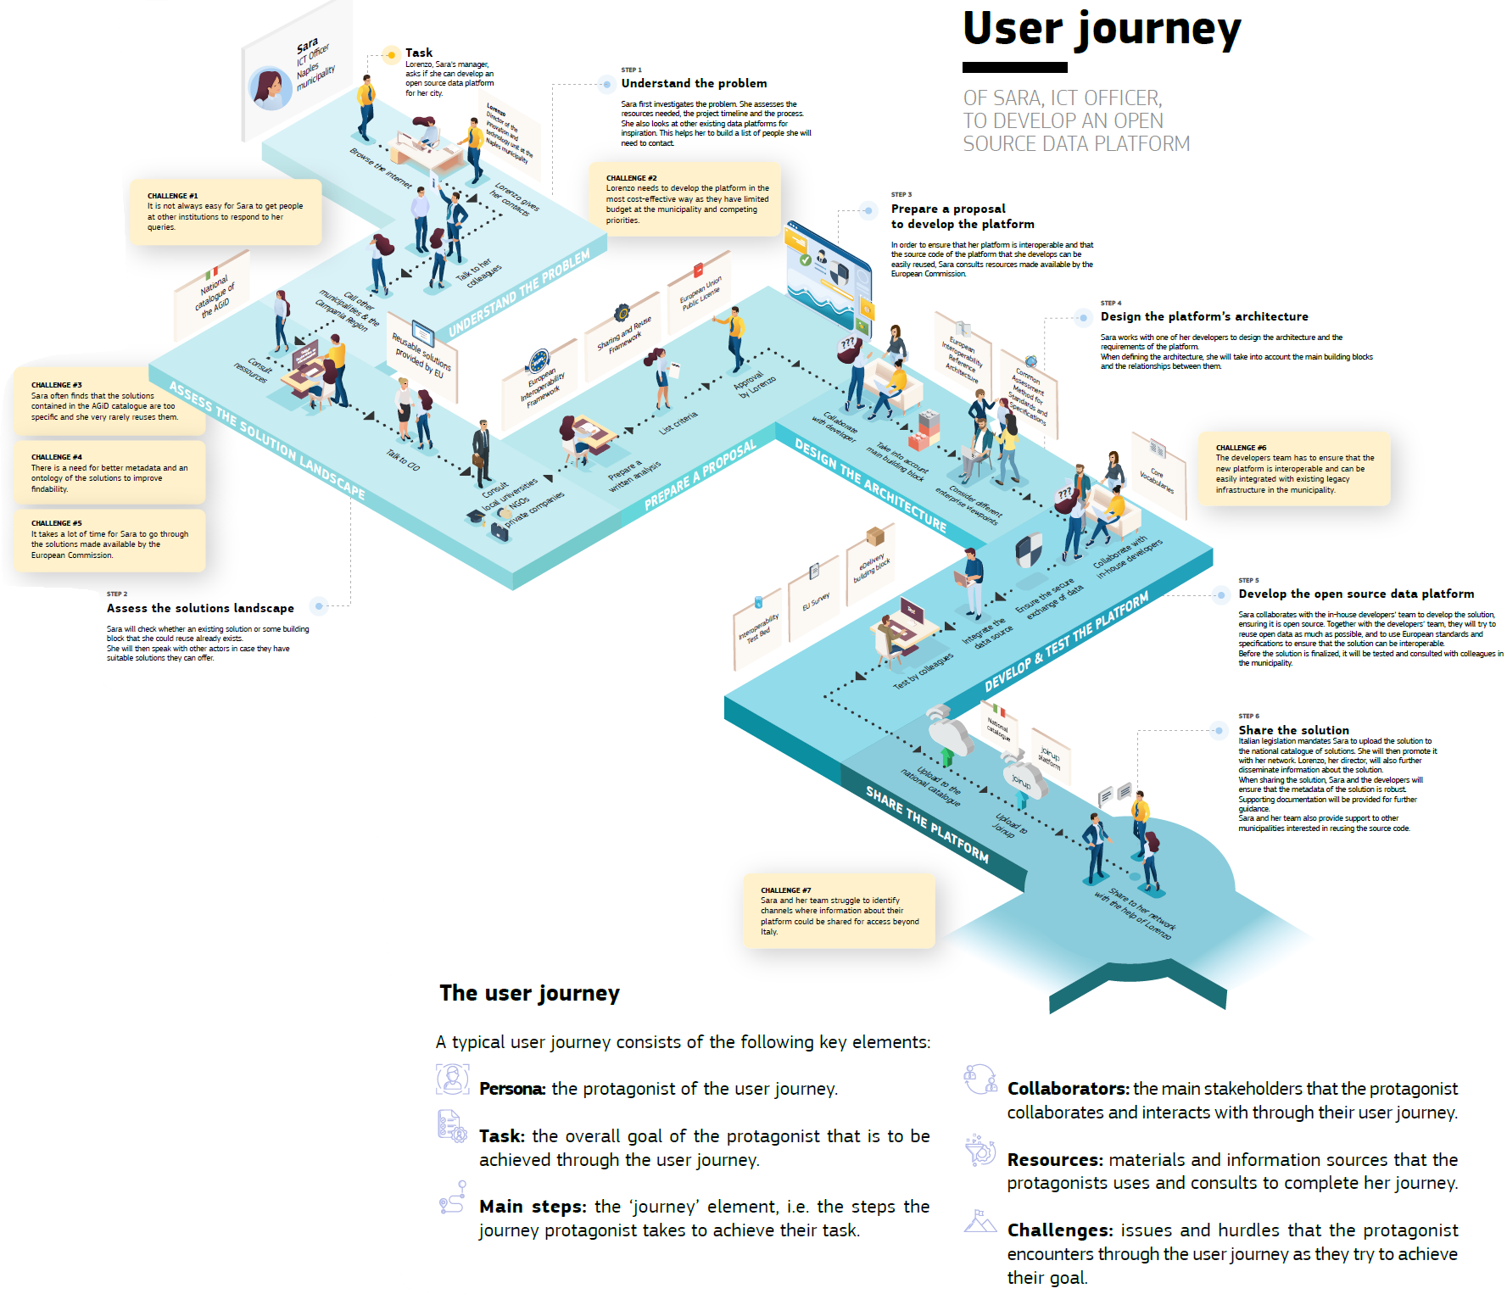
Building Digital Public Services

Slide 12
THANK YOU!

