Slide 1
LAND REGISTRAR’S STATUTE IN EUROPE

Slide 2
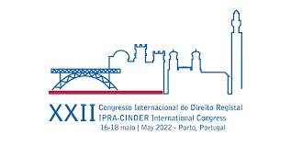
PREVIOUS WORK:
2 FACT SHEETS
STUDY REGARDING LAND REGISTRAR’S STATUTE
STUDY REGARDING LAND REGISTRAR’S LIABILITY

Slide 3
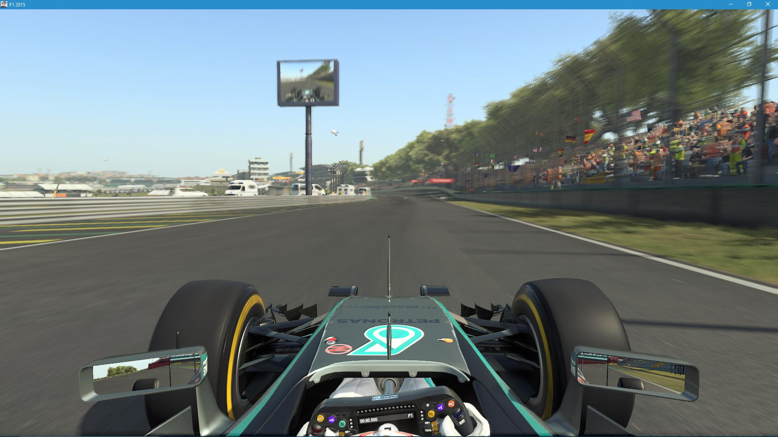
WHO’S BEHIND THE WHEEL?

Slide 4
SYSTEM
SOCIETY (LAW)
LAND REGISTRAR

Slide 5
SYSTEM
SOCIETY (LAW)
LAND REGISTRAR

Slide 6
SYSTEM
SOCIETY (LAW)
LAND REGISTRAR

Slide 7
QUESTIONNAIRE:
19 MS CONTACT POINTS:
- Austria, Bulgaria, Croatia, Cyprus, Estonia, Finland, Greece, Ireland, Italy (Libro Fundiario), Lithuania, Luxembourg, Malta, The Netherlands, Poland, Portugal, Romania (land registrar’s association), Slovakia, Spain, Sweden.

Slide 8
QUESTIONNAIRE:
19 MS CONTACT POINTS:
- Austria, Bulgaria, Croatia, Cyprus, Estonia, Finland, Greece, Ireland, Italy (Libro Fundiario), Lithuania, Luxembourg, Malta, The Netherlands, Poland, Portugal, Romania (land registrar’s association), Slovakia, Spain, Sweden, Belgium

Slide 9
QUESTIONNAIRE:
7 LR – judicial power
5 LR – executive power , quasi-judicial procedure
7 LR – executive/administrative power

Slide 10
QUESTIONNAIRE:
12 LR - legal background
2 LR – legal background and alternatives
5 LR – no legal background required

Slide 11
QUESTIONNAIRE:
8 LR – requires special qualifications
11 LR – no special qualification required

Slide 12
QUESTIONNAIRE:
3,5 LR – EU legislation trainings
15 LR – nope...

Slide 13
QUESTIONNAIRE:
MAIN FEATURES:
independence/autonomy
Responsibility
Impartiality

Slide 14
QUESTIONNAIRE:
FEATURES TO BE PRESERVED IN EU STATUTE:
Independence or autonomy
Impartiality
Only subject to legal premises (in short, to law)
Exclusivity in the exercise of his duty
Responsibility
„guardians of the citizen’s rights”

Slide 15
QUESTIONNAIRE:
EU STATUTE IMPACT:
Benefit from different perspectives (i.e. Interconnection)
An instrument to protect the values like independence and autonomy
An expresion of general principles underlying land registry
A highlight of the role played by the land registry and for its better understanding
Useful for harmonized, transparent and secure interoperability of LR
It should highlight the need for protection of the inviolability an independence of the land registries, the absolut objectivity and the value of the land registrar’s decision
Should rely on national statutes
It is also a good chance of conflicting laws between MS

Slide 16
QUESTIONNAIRE:
EU STATUTE – PROTECTIVE MEASURES AND VALUES TO BE PROTECTED:
The role played in security of the civil traffic and economic growth
Decisional independence/economical independence
General (common) principles underlying land registries
Professional qualification and minimal rules for acceptance
Liability and responsibility
Adaptability without subordination ( IT tools)

Slide 17
INTERACTIONS
IT DEVELOPMENTS
SPECIALIZATIONS

Slide 18
Common denominator:
PURPOSE:
Mutual trust
Systemic balance
Synergic development
Best practices
National identity consolidation

Slide 19
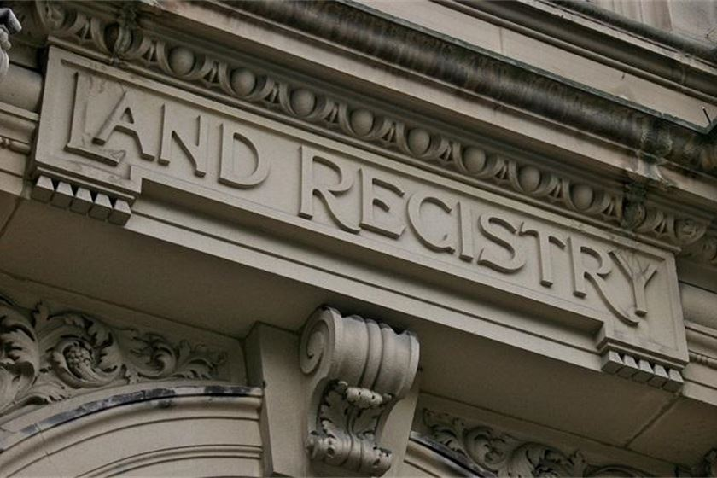
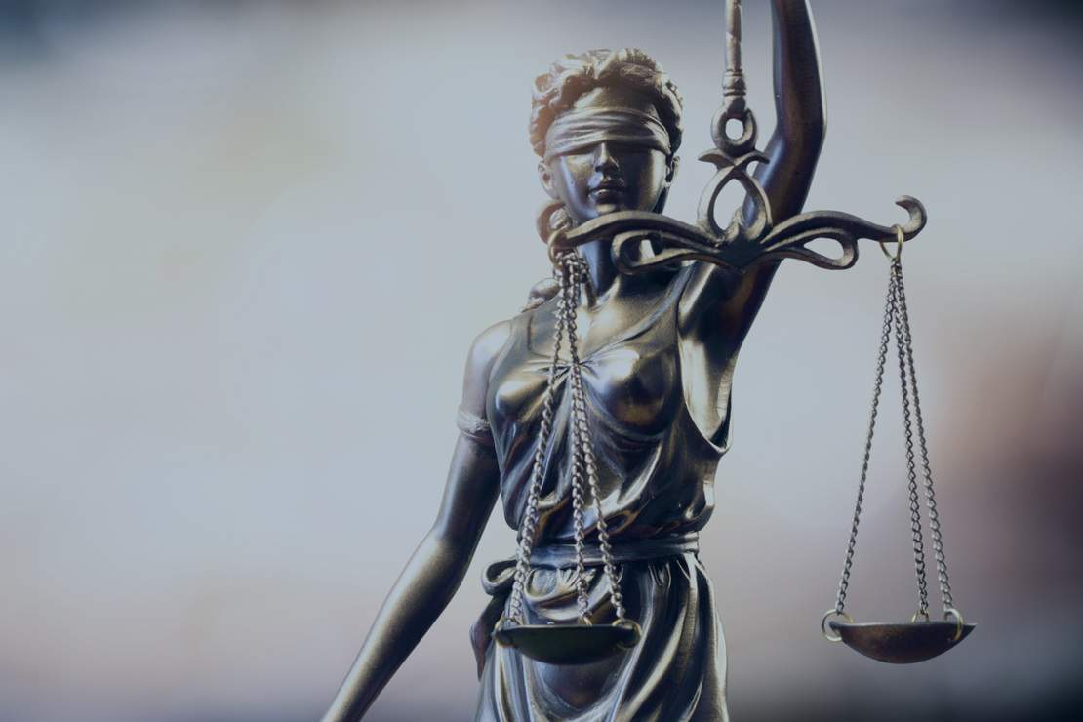
MUTUAL TRUST, BALANCE AND SYNERGY ARE CHARACTERISTICS OF CROSS-BORDER SECURITY SYSTEMS

Slide 20
Profile:
IS NOT ONLY THE LAND REGISTRY WHO’S CHANGING, BUT ALSO THE LAND REGISTRAR
MAIN FEATURES:
Stabel
Trained
Reliable
Organized
Neutral
Guarranted

Slide 21
GENERAL GUIDELINES:
Land registrars provides a public service in a distinct area of regulation, governed by its own rules, within one of the state’s power.
Land registrars are a national authority appointed by the state
The land registrar’s decisions are the expression of the state’s power.

Slide 22
GENERAL GUIDELINES:
The land registrar must be an expert in land registry law.
The land registrar's decision must be an independent decision
Land registrars contributes to economic growth and social peace. In order to accomplish their mission, they should benefit of stability in their appointment, professional integrity, legal protection and adequate level of independence, proffesional training and motivation.

Slide 23
Thank You!
Mihai Taus
Romanian Land Registrars Association
Mihai.taus@gmail.com

