Slide 1
Land Registry System in Türkiye
Emre Ergin Ergani
emreergani@tkgm.gov.tr
General Directorate of Land Registry and Cadastre, Türkiye
(www.tkgm.gov.tr)

Slide 2
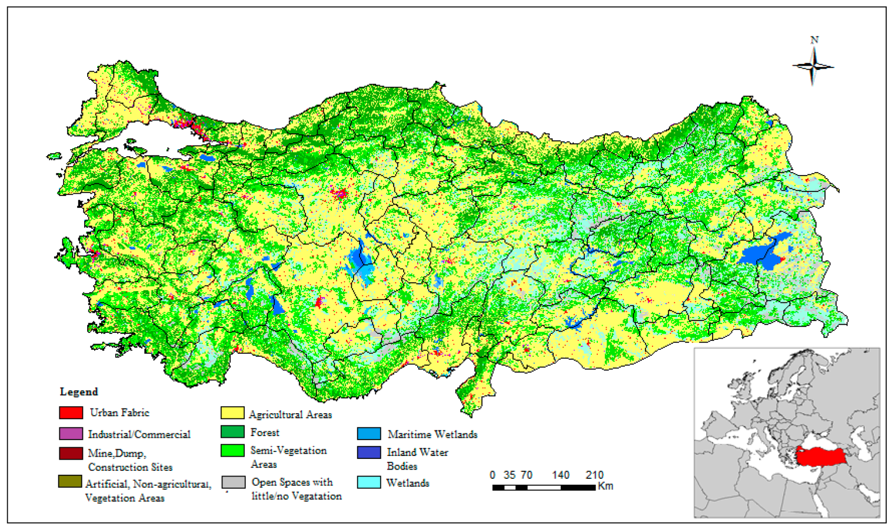
Türkiye at a Glance
784.000 sq km (770.000 land, 14.000 water)
84 million population
%77 rural, %23 urban (1927) (13.6 m)
%77 urban, %23 rural (2013)
Now: %93 urban
Ottoman Period-Land Regulations
Republic: 1923, Civil Code : 1926
Notes:
The table shows some information about Türkiye.
84 million people are living in Türkiye.
Türkiye is a country where 93% of its population lives in cities.

Slide 3
Land Registry System in Türkiye
Türkiye has an active land market. More than 2 million sales transactions are completed in 2021.

Slide 4
Land Registry System in Türkiye
We have been serving to almost 20 million people in a year.
The process is starting at local offices.The local officess providing direct services to the citizens and foreigners.

Slide 5
Land Registry System in Türkiye
Land registry and cadastre are organized under the same institution.
Notes:
I would like to introduce the organization.
GDLRC is directly funded by the Government.
There is a central Office in Ankara. There are 23 regional directorates throughout the country.
We have 1 cadastre directorate for each province and 1 land registry directorate for each district.
So, there are 81 cadastre and 974 land registry offices serving directly to the local stakeholders and citizens in the country.

Slide 6
Land Registry System in Türkiye
The General Directorate of Land Registry and Cadastre is the sole organization responsible for making sales contracts and keeping land registries.
A legal arrangement was made in this year for notaries to make sales contracts also but in practice it’s not started yet.
Notes:
Other kind of agreements which are arranged by notary services (construction agreement, preliminary contract for sale etc.) needs to be registred at the local offices.

Slide 7
Land Registry System in Türkiye
Property rights are guaranteed by the Constitution
1876 → Constitution (Ottoman Period)
1924→1st Constitution of The Republic
1954 → European Convention on Human Rights
1961→2nd Constitution of The Republic
1982→ Current Constitution
Notes:
Under Turkish law, the European Convention on Human Rights is equivalent to the constitution.

Slide 8
Land Registry System in Türkiye
Main Regulations
Civil Code (Since 1926)
Cadastre Law (Since 1925)
Land Registry Law (Since 1934)
Condominium Law (Since 1965)
Notes:
We have four main laws, different technical regulations.
Apart from these main laws, laws such as zoning law and agricultural land protection law also guides property law.
The main purpose of these laws and regulations are always defined as establishing land registers, under state guarentee.
In order to to fit this purpose, various technical and administrative regulations came into force.

Slide 9
Land Registry System in Türkiye
Cadastre; as a tool for establishing land registries
Land registration → is the process of recording rights in land in the title registry, under the state guarantee (Civil Code 1007)
Notes:
According to the civil code which was adopted from the switzerland in 1926. Right after foundation of the Turkish Republic, keeping and maintaing the land registry in Türkiye under state guarentee.
İt means that, any loss or damages arising from errors occuring in land registers have to be compensated by the state.
The state recourses the compensation to the civil servent who caused the payment of this compensation due to her/his fault.

Slide 10
Land Registry System in Türkiye
Ownership, Easements (personal/real), incumbrance, liens (mortgage etc), restrictions (public, private) and responsibilities (Civil Code Article 1000)
The RRR (rights, responsibilities and restrictions) are registered into the land registery and these are also under the state guarantee.

Slide 11
Land Registry System in Türkiye
The immovables that can be registered in the land registry are as follows;
Lands
Individual units registered to condominium ownership books such as house, workplace etc.
Independent and permanent rights that are recorded to a seperate page in the land registry (e.g. rights of construction, easements)

Slide 12
Land Registry System in Türkiye
58.5 million parcels
22.5 million individual units
52.4 million total owner
%60 men, %40 women
3.8 million state owned
9.5 million legal person
300.000
Foreign Ownership
Notes:
An empty page from ledger. One page (folio) is defined per property.
The parcel-baced system is implemented.
Without registration the ownership does not come to effect.
These are some land registration statistics from Türkiye.

Slide 13
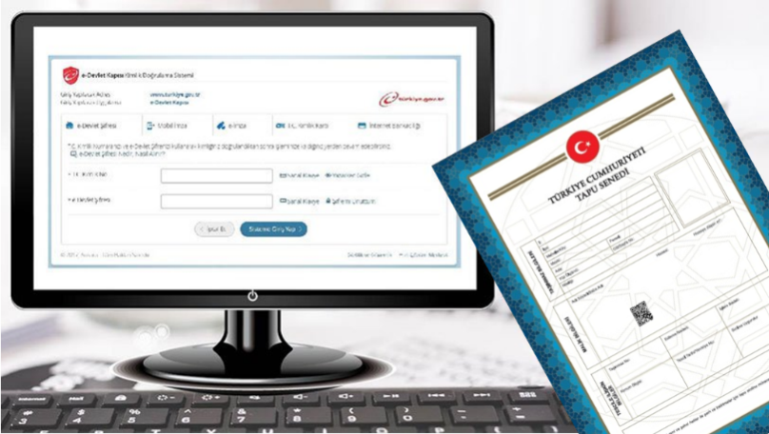
Land Registry System in Türkiye
The dual registration system is still maintained.
The ledgers are still in use.
It is planned to end the registration procedure to the ledgers in the near future. Works are still in progress.

Slide 14
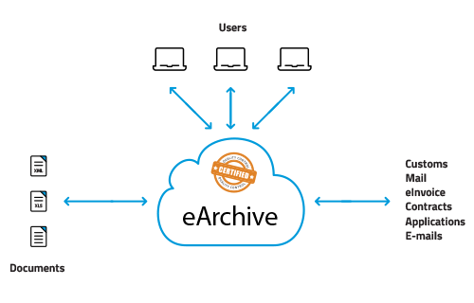
Land Registry System in Türkiye
The physical archives of the land registry offices are transferred to the electronic environment
Notes:
Land registry information stored in electronic and paper format both.

Slide 15
Land Registry System In Türkiye
Since 2012, all transactions have to be made through land registry and cadastre information system (TAKBİS) throughout the country, which has a centralised IT infrastructure.

Slide 16
Land Registry System in Türkiye
Land registry records on TAKBİS are shared with other institutions and partners
We share data with 1531 public institutions
(e.g.Ministry of Finance, Ministry of Justice, Ministry of Agriculture and Forestry, Municipalities..)

Slide 17
Land Registry System in Türkiye
Through web aplication system called Webtapu, it is possible to apply the land registry office online, to reach the title deeds and examine the status of the real estate.
Notes:
Webtapu system emerged before the COVID19 days, but shined out during pandemic days is web application system for land registery.
With web land registry, parties can apply to any transaction without going to the local directorates.
The related documents can be sent to the directorates beforehand. The fees can be paid electronicly, the transaction stages can be followed.
However, the parties still have to go to the local directorated for wet signatures.

Slide 18
Land Registry System in Türkiye
Before the pandemic, the number of Webtapu users was 180,000.
In 2021, the number of Webtapu users reached 4.742.986
An arrange of 15.000 transaction applications are made per day
As a result it makes application procedures faster, safer and healthier…

Slide 19
CHALLANGES
The challanges can be classified as ;
Content
Quality
Reliability, accuracy
ICT
Personal Data Protection
Notes:
We have a centralised land registry and cadastre information system. However there are still big challanges behind the way towards a comprehensive electronic land registry and cadastre system in Turkey.

Slide 20
Land Registry System in Türkiye
Thank you for listening…
Emre Ergin Ergani
Land Registry and Cadastre Expert
General Directorate of Land Registry and Cadastre
emreergani@tkgm.gov.tr

