Slide 1
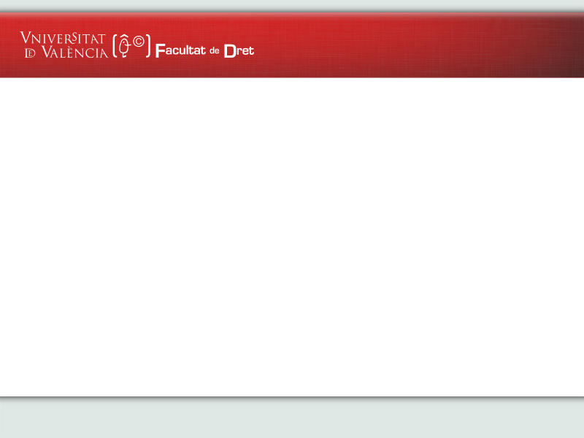


THE INTERNATIONAL CIRCULATION OF DIGITAL PUBLIC DOCUMENTS
Prof. Dr. Guillermo Palao,
Professor in International Private Law at Valencia University
ELRN WORKSHOP
Málaga, 24 November 2022

Slide 2
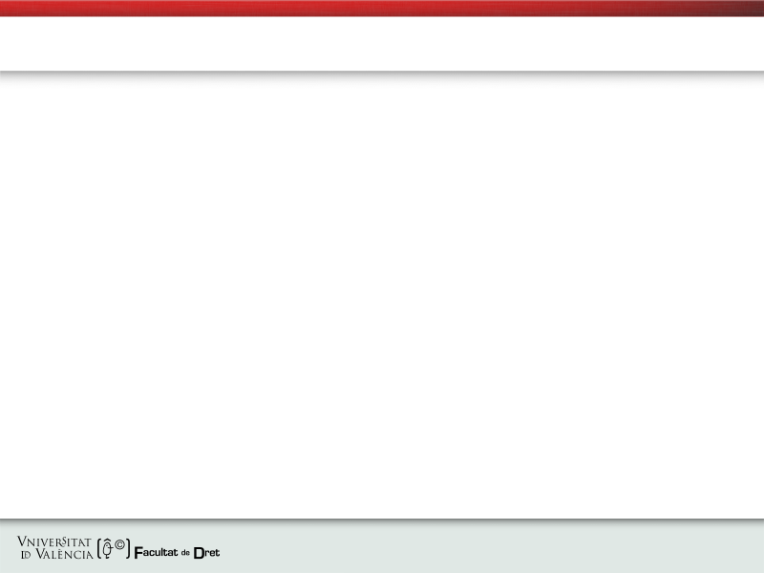
“The international circulation of digital public documents” Prof. Dr. G. Palao (ELRN, Málaga, 24 Nov 2022)
● TOWADS THE DIGITALIZATION OF LAND REGISTRIES: A WORK IN PROGRESS
→ The increasing digitalisation of national Land Registries within the EU: digital transformation of public administration
→ From Digitation to digitalisation of public (e-) documents and (e-) Land Registries
→ Legal challenges for cross-border circulation of public documents in a digital form and Land Registries
→ National, EU and International regulatory initiatives and the existing challenges for cross-border cases
→ The important role played by ELRA and the ELRN

Slide 3
“The international circulation of digital public documents” Prof. Dr. G. Palao (ELRN, Málaga, 24 Nov 2022)
● COMMON FEATURES OF NATIONAL INITIATIVES RELATED TO THE DIGITIZATION OF LAND REGISTRIES
→ To adapt traditional analogical systems of national Land Registries to the current and increasing digital reality (benefits and challenges)
→ The increasing use of IT tools for the conveyancing and for the registration process in national Land Registries
→ The importance of an adequate legal framework also relating to the Protection of Personal Data and the Respect of Fundamental Rights

Slide 4
“The international circulation of digital public documents” Prof. Dr. G. Palao (ELRN, Málaga, 24 Nov 2022)
● OBSTACLES WHICH NATIONAL INITIATIVES MEET RELATED TO THE DIGITIZATION OF LAND REGISTRIES IN RELATION TO CROSS-BORDER SITUATIONS (I)
→ A different level of development of MS of both regulatory measures and technological tools in the (e) processes of national public administrations (national particularities)
→ Differences affecting also to national solutions providing for the electronic conveyancing and registration processes before national Land Registries
→ A limited (or even excluded) electronic access of foreign public authorities to (e-) Land Registries of the MS

Slide 5
“The international circulation of digital public documents” Prof. Dr. G. Palao (ELRN, Málaga, 24 Nov 2022)
● OBSTACLES WHICH NATIONAL INITIATIVES MEET RELATED TO THE DIGITIZATION OF LAND REGISTRIES IN RELATION TO CROSS-BORDER SITUATIONS (II)
→ The common requirement of double documentation at the MS of origin and at the MS of destination
→ The lack of awareness of the international elements which could affect digital documents: national solutions and the subsidiary application of Private International Law rules
→ The need to allow more flexibility and to developed supra-national legal initiatives in this area, for a greater level of cooperation

Slide 6
“The international circulation of digital public documents” Prof. Dr. G. Palao (ELRN, Málaga, 24 Nov 2022)
● THE LIMITS OF THE HCCH E-APOSTILLE PILOT PROGRAMME (E-APP)
→ From Convention of 5 October 1961 to the “electronic Apostille Programme” (“the e-App”)
→ Main technological elements: e-Apostilles and e-Registers
→ Cooperation and obligations for Contracting Parties
→ A growing and sound application, but still there is room for more Contracting parties

Slide 7
“The international circulation of digital public documents” Prof. Dr. G. Palao (ELRN, Málaga, 24 Nov 2022)
● THE (NON) APPLICATION OF REGULATION (EU) 2016/1191 TO DIGITAL PUBLIC DOCUMENTS ACCESING LAND REGISTRIES
→ The intra-European circulation of public documents: the development of an Area of freedom, security and justice (Art. 67 TFEU)
→ Regulations in the field EU Justice policy do offer a limited solution and they do not relate to digital public documents (Principles of digital neutrality and functional equivalence)
→ Regulation (EU) 2016/1191 on promoting the free movement of citizens by simplifying the requirements for presenting certain public documents in the European Union and amending Regulation (EU) No 1024/2012
→ Its non-application to Land Registry (e-) documents (Art. 2)

Slide 8
“The international circulation of digital public documents” Prof. Dr. G. Palao (ELRN, Málaga, 24 Nov 2022)
● THE PERSISTENCE OF LEGAL PROBLEMS IN RELATION TO LAND REGISTRIES AND THE NEED TO RECONSIDER THE CURRENT MODEL FROM THE EU
→ The EU Principle of mutual recognition, unlike court decisions, is not fully guaranteed in the field of public (e-) documents yet
→ Disparities of national solutions within the EU and the lack of international Conventions applicable to all MS
→ The need to develop an EU legal framework which eliminates current legal obstacles and provide for the free movement and mutual recognition in relation to public (e-) documents accessing Land Registries

Slide 9
“The international circulation of digital public documents” Prof. Dr. G. Palao (ELRN, Málaga, 24 Nov 2022)
● THE DIGITAL ELEMENTS OF AN EVENTUAL FUTURE EU MODEL FOR THE CROSS-BORDER CIRCULATION OF PUBLIC (e) DOCUMENTS (I) THE BASIS OF THE POSSIBLE MODEL
→ Full application and development of Art. 67 TFEU
→ The development of a Single Digital Market for the EU and its implications for public (e-) documents
→ Accessibility and transparency of Land Registry information (e-Justice Portal) and to facilitate the registration of cross-border public (e-) documents (e-Codex)
→ Taking full advantage of the opportunities offered by IT, and reducing legal obstacles to the cross-border circulation of public (e-) documents
→ Protection of personal data and Respect of Fundamental Rights

Slide 10
“The international circulation of digital public documents” Prof. Dr. G. Palao (ELRN, Málaga, 24 Nov 2022)
● THE DIGITAL ELEMENTS OF AN EVENTUAL FUTURE EU MODEL FOR THE CROSS-BORDER CIRCULATION OF (e) PUBLIC DOCUMENTS (II) THE POSSIBLE OPERATION OF THE MODEL
→ The importance of ELRA initiatives and impact in future EU initiatives: the ELRN, the ELRD and the successive CROBECO and IMOLA Projects
→ The need of a full guarantee, from the perspective of UE institutions, of the free circulation and the mutual recognition for public (e-) documents
→ Final Objtective: the control of the authenticity and validity of the public (e-) document by the MS of origin, while respecting local Land Registry Regulations and requirements of the MS of destination

Slide 11
“The international circulation of digital public documents” Prof. Dr. G. Palao (ELRN, Málaga, 24 Nov 2022)
● THE DIGITAL ELEMENTS OF AN EVENTUAL FUTURE EU MODEL FOR THE CROSS-BORDER CIRCULATION OF (e) PUBLIC DOCUMENTS (II) THE POSSIBLE OPERATION OF THE MODEL (continue)
→ Technical elements:
Land Registers Interconnection and interoperation through a decentralised IT system (e-Codex)
Direct (e) communication and cooperation Information and assistance tools (e-Justice)
Providing access to foreign authorities from other MS (e-Codex)
Multilingual Annexes with standard (e-) documents (i.e. ELRD)
The development of (e) accessible Manual, Glossary and a common semantic model (i.e. IMOLA, EU Adapt Project)
Guidelines, FAQ, and Good practices

Slide 12


Thank you¡
¡Muchas gracias!

