Slide 2
I. COOPERATION WITH the European Judicial Network (EJN)

Slide 3
» Brussels, 27th – 28th January: 20th Annual meeting (general information)
» Paris, February 24th – 25th Regulations (EC) NO 2201/2003 (The Brussels IIa) and (EU) 2019/1111
Overview of recent case law of the Court of Justice of the European Union (CJEU) on the Brussels IIa Regulation
The impact of the Brussels IIb Regulation on cross-border placements
» Brussels, May 12th – 13th Regulation (EU) No 1215/2012 (The Brussels IIa) and Regulation and 805/2004:
Legal study on the application of Brussels Ia: Info point and discussion
Cross-border enforcement and the EU Enforcement Atlas

Slide 4
» Brussels, June 23rd 24th Regulations 1206/2001, 1393/2007, 2020/1783 and 2020/1784:
Service of Documents and Taking of Evidence Regulations
» Brussels, September 8th : High-level conference on Brussels IIb Regulation (Matrimonial matters and matters of parental responsibility)
The road to Brussels IIb and the key changes introduced by the Regulation.
Applying Brussels IIb - The updated Practice Guide to the Regulation
Mediation in the spotlight - the role of mediation in cross-border family disputes under Brussels IIb

Slide 5
» Brussels, June 23rd – 24th Cross-border protection of vulnerable adults:
Application of the 2000 Hague Convention
Experience of State Parties, acceding State Parties, and non-State Parties to the 2000 Hague Convention with cross-border protection of vulnerable adults
Interplay between the Hague Conventions and EU Regulations: The way forward within the EU.
Current challenges in cross-border protection of vulnerable adults: Scope of the EU instrument complementary to the 2000 Hague Convention.

Slide 6
II. COOPERATION WITH the EUROPEAN COMMISSION

Slide 7
» DG FISMA
Member of the Task Force sub-group on “asset freezes and reporting”
Expertise requested on Council implementing regulation (EU) 2022/396 of 9 March 2022 implementing Regulation (EU) No 269/2014 concerning restrictive measures in respect of actions undermining or threatening the territorial integrity, sovereignty and independence of Ukraine.
» DG JUSTICE
Collaboration request on the cross-border protection of adults for evaluating the impact of all the policy options on citizens, stakeholders, and public administrations

Slide 8
III. MAIN ACTIVITIES – WORKSHOPS

Slide 9
1st Workshop, Brussels 3rd March:
Succession Regulation (EU) No 650/2012 EU Land Registry Common Principles by Marta Rekawek -Pachwicewicz, Chief Specialist – Judge, EU Law Department, Ministry of Justice, Poland.
Study on Regulation (EU) 2018/1805 on the mutual recognition of freezing orders and confiscation orders by Jorge López, Land Registrar
Digital transformation: Digitalization of paper documents by Agostina Lodde, CP from Agenzie delle Entrate.
Report on 3D representation in the Land Registry by Joke De Wit by General Administration of the Patrimonial Documentation from Belgium
Comparative study: Republic of Croatia and ELRA member states land registry systems, Ivica Anaković, CP from Croatia

Slide 10
2nd Workshop, 17th June – On-line :
Implementation of restrictive measures in the framework of Regulation (EU) 2022/396, by Michael Stelzer Deputy Head Unit of Sanctions (DG FISMA E.5)
Study on free movement of public documents by Fernando de la Puente, Business Registrar.
Data Protection in the Land Registry by Filipa Calvão, President of the National Data Protection Committee, Portugal.
3rd Workshop, Málaga 24th November:
Study on Regulation (EU) 2018/1805 on the mutual recognition of freezing orders and confiscation orders by Jorge López, Spanish Land Registrar
Data Protection in the Land Registry by Claude Sapiano, CP from Malta
Ongoing study on free movement of public documents Fernando de la Puente
Cross-border protection of vulnerable adults and minors
Study on Regulation 2015/848 on insolvency proceedings by Blandina Soares, Conservadora dos Registo Civil, Predial e Comercial de Portugal

Slide 11
IV.
DELIVERABLES IN 2022

Slide 12
Study on the digitalization of paper documents by Agostina Lodde (CP from Agenzie delle Entrate)
Report on 3D representation in the Land Registry the General Administration of the Patrimonial Documentation from Belgium
Report on the land registration aspects of Regulation (EU) No 650/2012, (articles 66.5 and 69.5), and the study case C-301/20 regarding the validity of a certified copy not having an expiration date.
Study on Regulation (EU) 2018/1805 on the mutual recognition of freezing orders and confiscation orders - to complete Fact Sheet on Judicial restrictions
Update of the information published on the Regulation 2015/848 on insolvency proceedings
Data Protection in the Land Registry regarding countries having an online system of registration. Does Data Protection limit the information that can be easily accessed? If so, what information is held from being made public?
Study on free movement of public documents – ongoing 2023

Slide 13
FUTURE ACTIVITIES 2023
3 Workshops are scheduled:
8th March (online)
24th - 25th May (Stockholm)
24th - 25th November (Brussels)

Slide 14
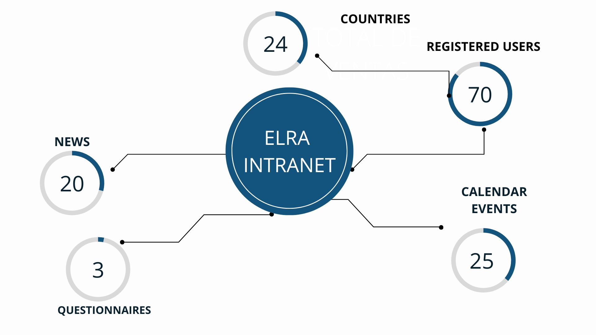

Slide 15
EUROPEAN SURVEY
From 2022, ELRA as Beneficiary of the Operating Grant is required to fill the EU survey on Justice, Rights and Values in order to collect the feedback of the participants of the events organized in the framework of our project:
You have just received an email with the survey. Please complete it during the event or right after and send us your replies!

Slide 16
Directory: The Board of Directors and the Secretariat appear on the front page. Then you can select the countries in alphabetical order.
ELRA Secretary General - ELRN Coordinator
24th November 2022

