Slide 1
Rights of Nature and the possible effects in LR
Jacques Vos | 20240311
ELRN workshop

Slide 2
AGENDA
* What is ‘Rights for Nature’?
- history & purpose
* How to give Rights to Nature?
- current status
* What does this (possibly) mean for LR?

Slide 3
AGENDA
* What is ‘Rights for Nature’?
- history & purpose
* How to give Rights to Nature?
- current status
* What does this (possibly) mean for LR?

Slide 4
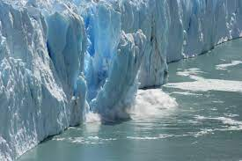
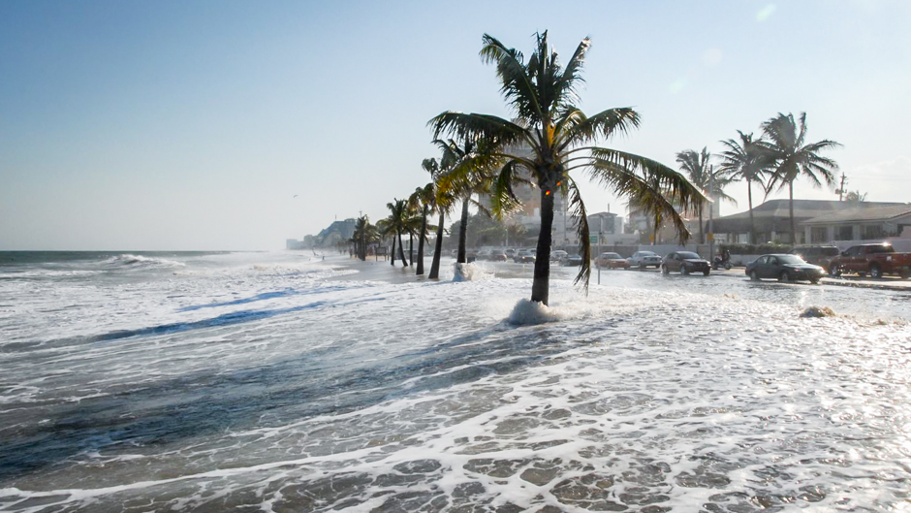
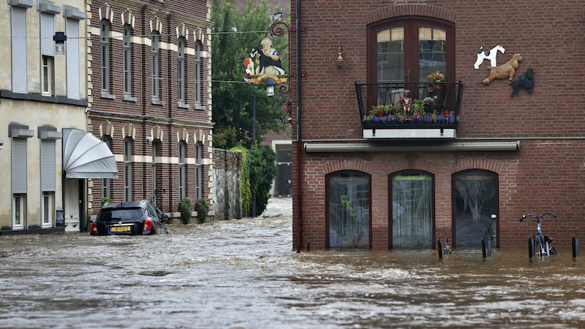
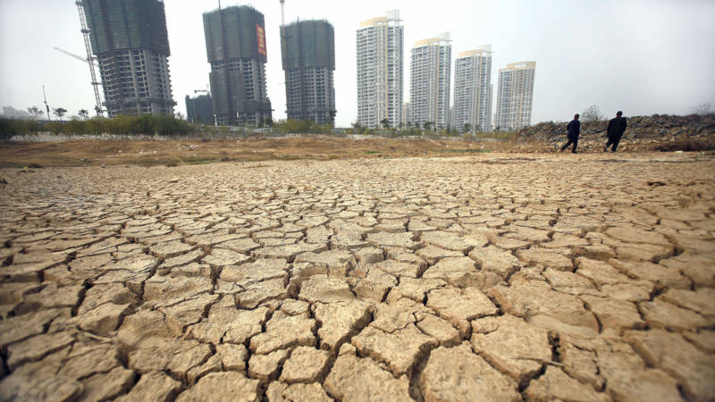
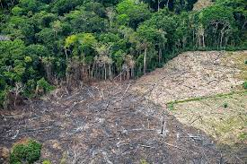
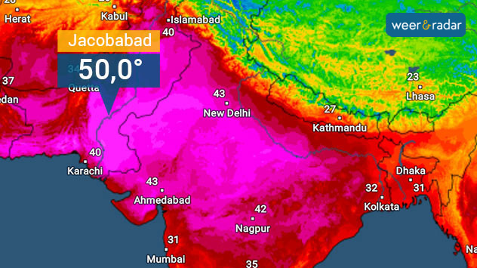
What is ‘Rights for Nature’

Slide 5
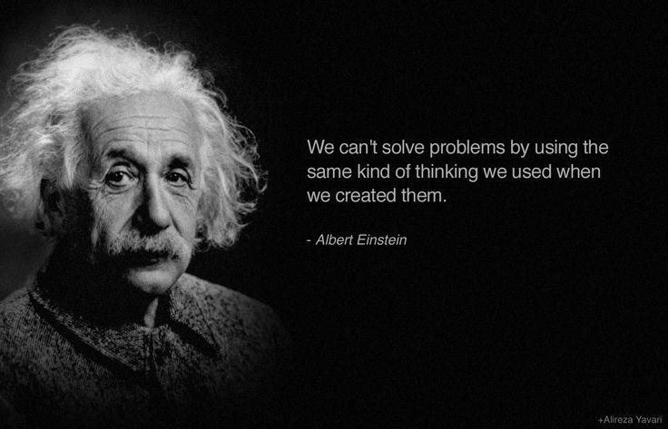
What is ‘Rights for Nature’ (2)

Slide 6
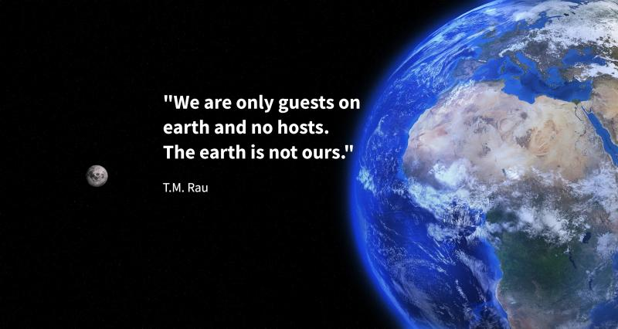
What is ‘Rights for Nature’ (3)

Slide 7
What is ‘Rights for Nature’ (4)
Sierra Club v. Morton,Surpreme Court April 19, 1972
Dissenting opinion (Justice William O. Douglas)
“Contemporary public concern for protecting nature’s ecological equilibrium, should lead to the conferral of standing upon environmental objects to sue for their own preservation.”

Slide 8
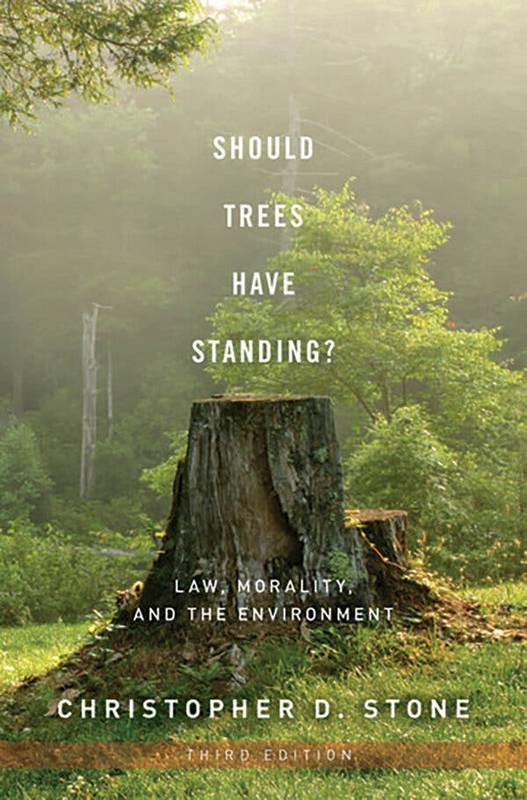
What is ‘Rights for Nature’ (5)
Professor Christopher Stone:
“I am very seriously proposing that
we give legal rights to forests, oceans,
rivers and other so-called
‘natural objects’ in the environment.”

Slide 9
What is ‘Rights for Nature’ (6)
Holistic world view → no direct benefit for humans
Not depending on political views & changes
Its protection is not always good for people

Slide 10
AGENDA
* What is ‘Rights for Nature’?
- history & purpose
* How to give Rights to Nature?
- current status
* What does this (possibly) mean for LR?

Slide 11
How to give Rights to Nature?
Rapidly growing trend toward truly including nature
Various levels: municipal, tribal, national level
Nature as a ‘legal person’

Slide 12
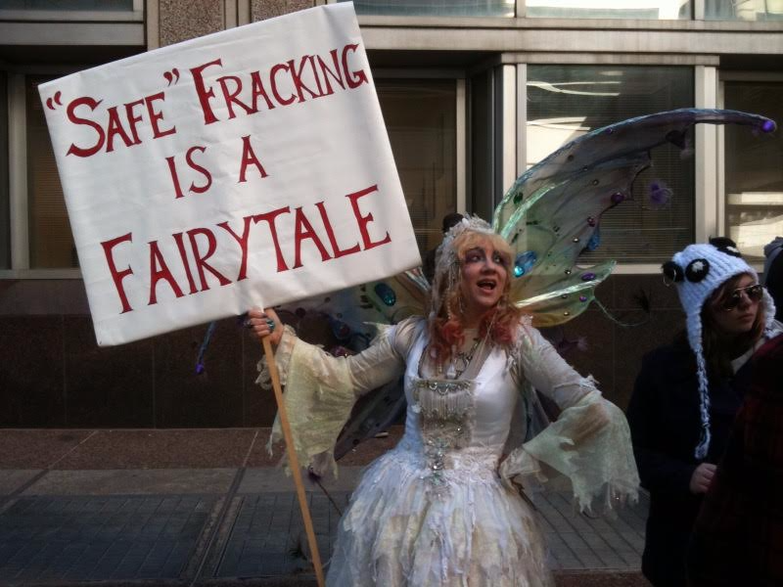
How to give Rights to Nature? (2)
USA:
Pittsburgh (2010)
& many afterwards

Slide 13
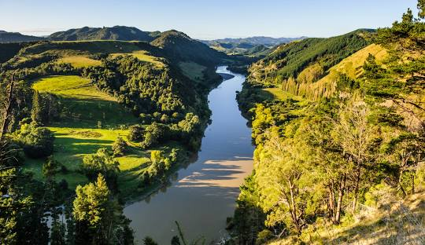
How to give Rights to Nature? (3)
New Zealand:
Whanganui River (2017)
“I am the river and the
river is me.”

Slide 14
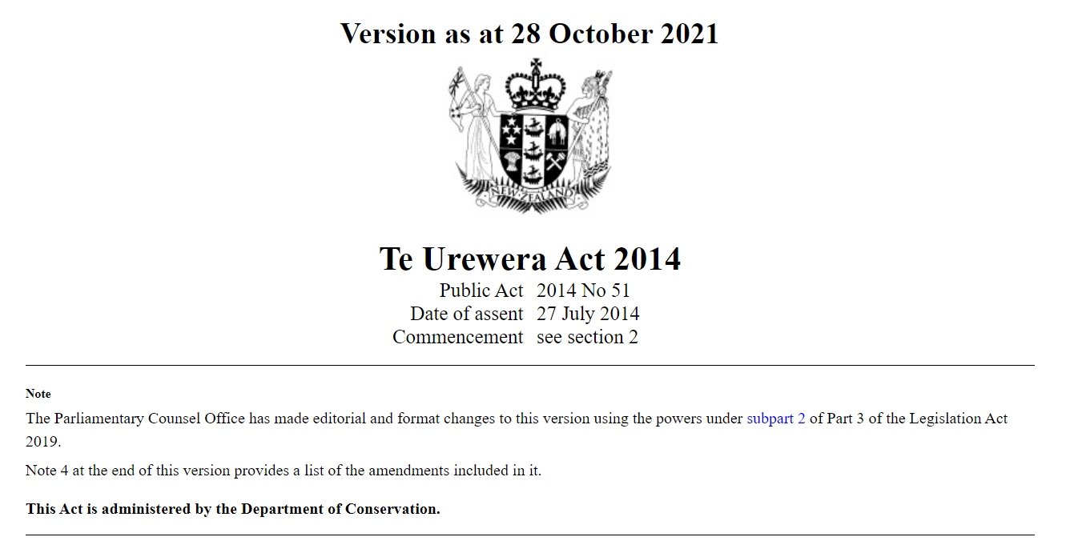
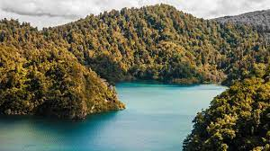
How to give Rights to Nature? (4)
Te Urewera (2014):

Slide 15
How to give Rights to Nature? (5)
Ecuador
Constitutional Rights for Nature (2008)
First country ever that
embedded Rights of Nature
in its Constitution.

Slide 16
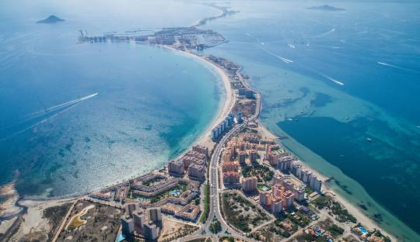
How to give Rights to Nature? (6)
Spain
Mar Menor lagoon (2022)
Ley de Recuperación y
Protección del Mar Menor

Slide 17
AGENDA
* What is ‘Rights for Nature’?
- history & purpose
* How to give Rights to Nature?
- current status
* What does this (possibly) mean for LR?

Slide 18
SUBJECT
Land Registers
RIGHT
IN REM
OBJECT
Land and Poverty Conference 2019, Washington
Jacques Vos, Kadaster

Slide 19
Land Registers
RIGHT
IN REM
OBJECT ?
SUBJECT

Slide 20
GUARDIAN?
SUBJECT
Land Registers
RIGHT
IN REM
OBJECT
Land and Poverty Conference 2019, Washington
Jacques Vos, Kadaster

Slide 21
What does this (possibily) mean for LR?
In the case of: could this perhaps mean:
Pittsburgh (positive) obligation/ limitation/ notice?
India Registration of Court ruling?
Ecuador Nothing to be changed?
Spain Nothing to be changed/ legal limitation?
New Zealand Complete change of the Land Registry situation

Slide 22
Towards a European Convention of Nature Rights?
Local or tribal law (e.g. Pittsburgh)
Court ruling (e.g. India)
National law (e.g. Spain & New Zealand)
Constitutional law (e.g. Ecuador)

Slide 23
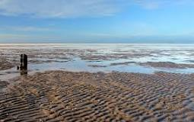
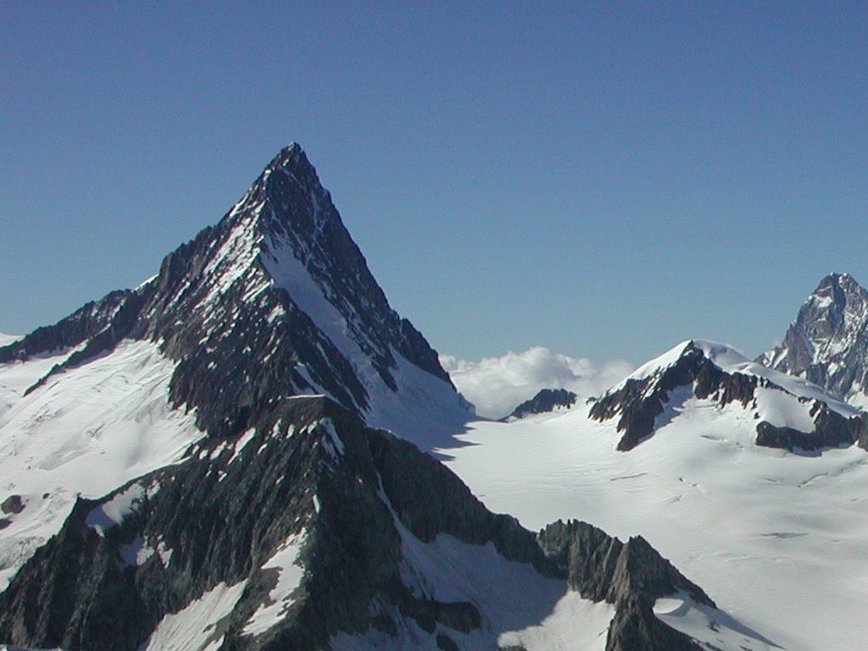
What will happen if… ?
Wadden Sea (NL) will have Rights of Nature?
But the Finsteraarhorn (CH) will not?

Slide 24
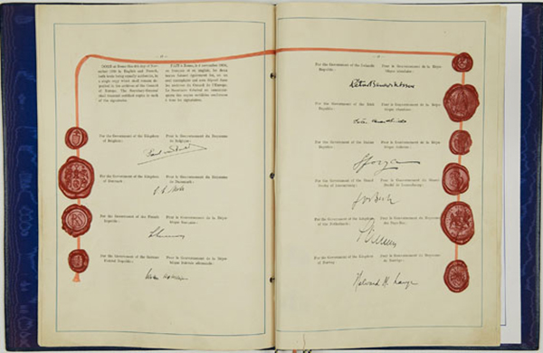
Is there a need for … ?
European Convention on human Rights (1950)
European Convention on Nature Rights?

Slide 25
If yes, two key questions remain..
What will happen with the civil-law right of ownership/proprietorship?
What will be the possible effect to Land Registry?

Slide 26
Thank you very much for your attention
Jacques Vos | 20240311
ELRN workshop

