Slide 1

data ‘ownership’ and Land Registration
The new frontier: digital succession

Slide 2
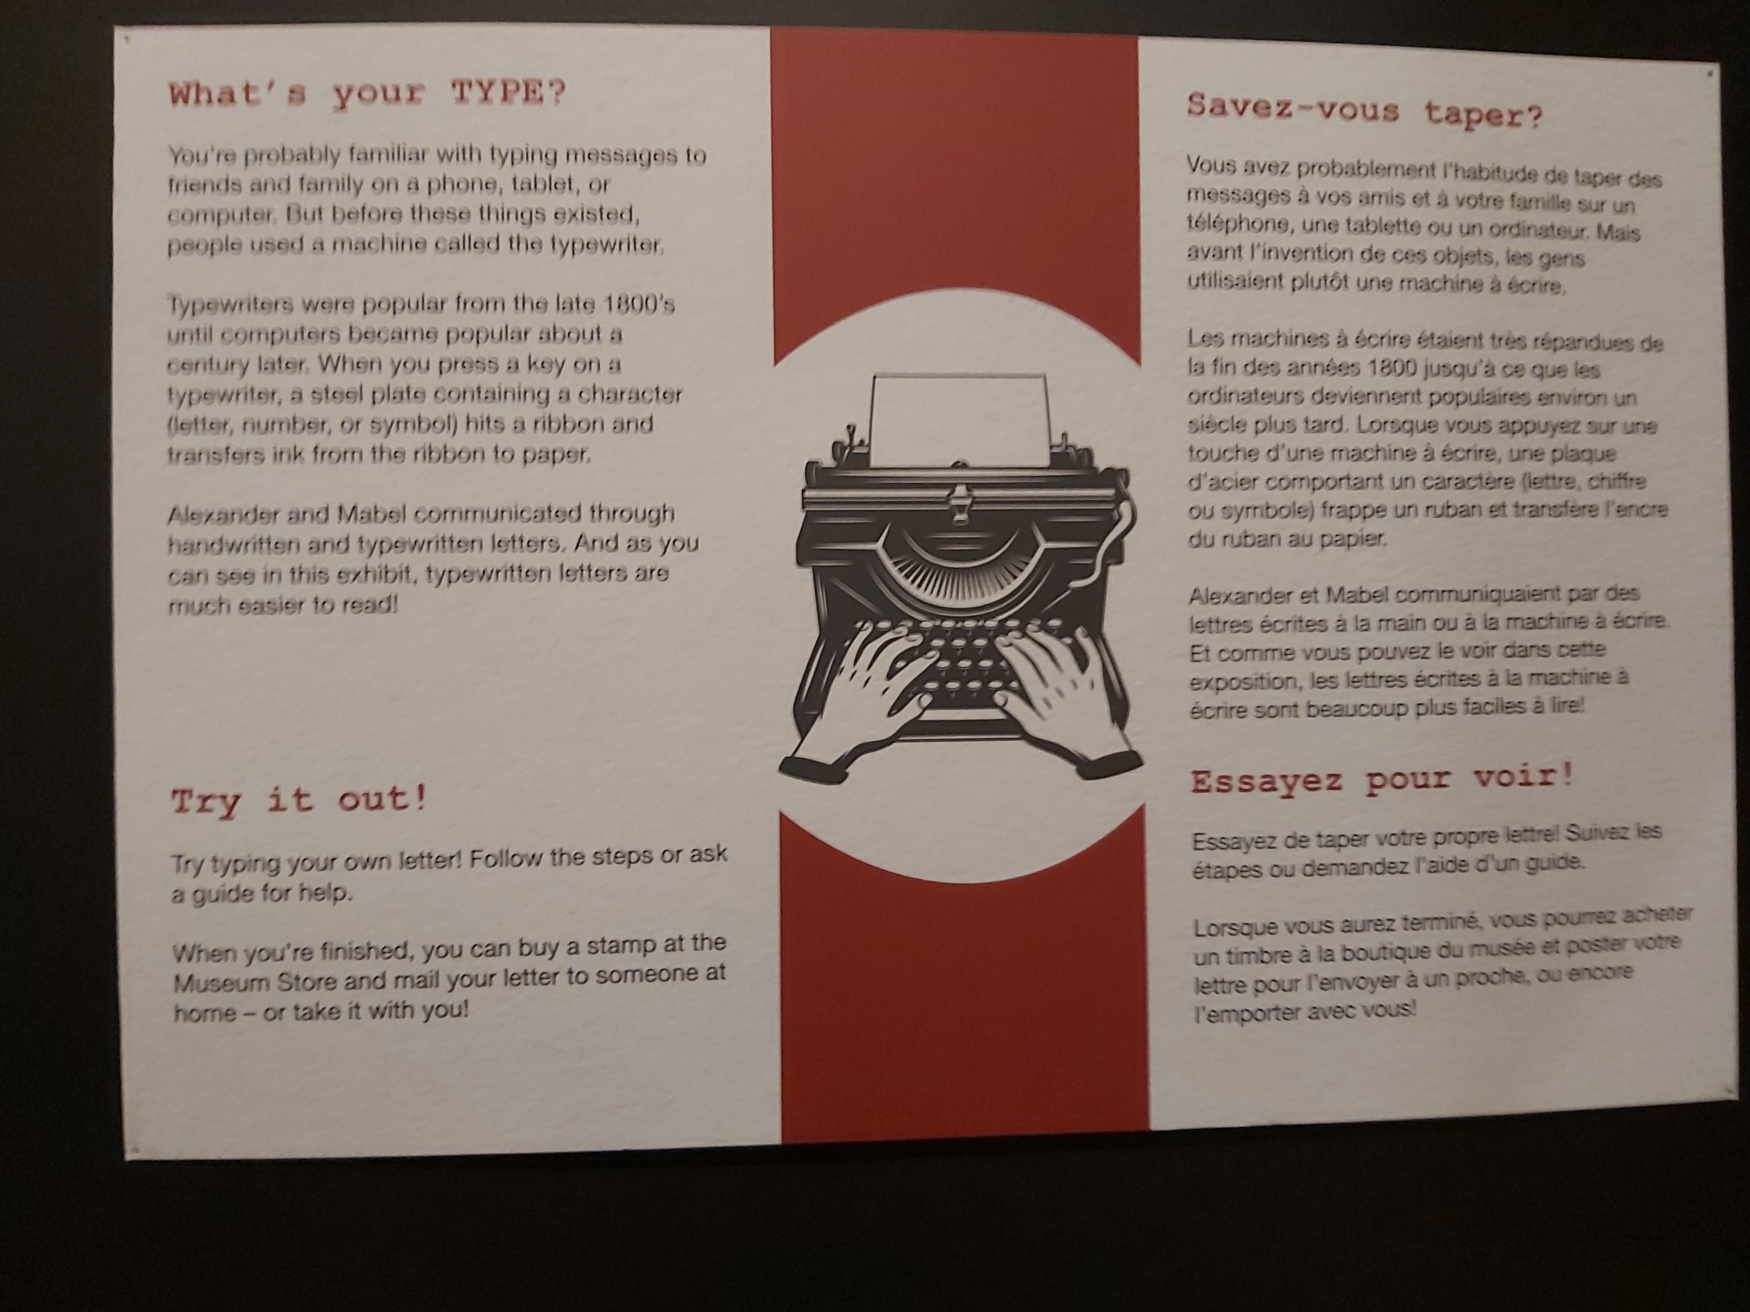
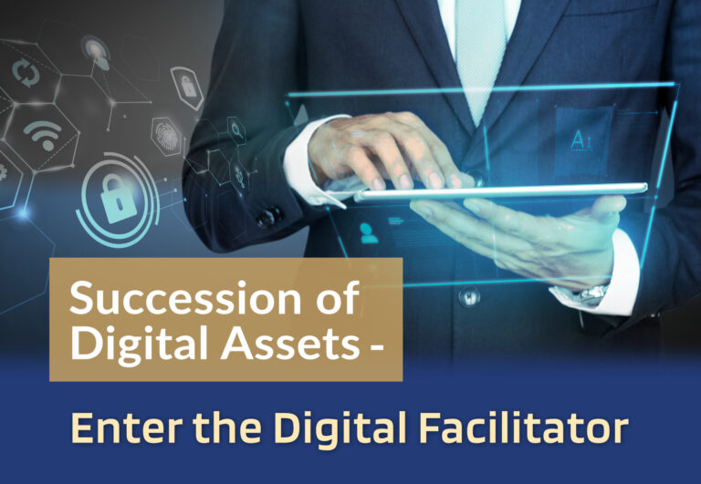
data ‘ownership’ and Land Registration

Slide 3

data ‘ownership’ and Land Registration
  Introduction
  A traditional view on a person’s ‘patrimony’ (‘estate’)
  A changing view on ‘object’ and ‘subject’, and consequently ‘legal relationships’
  Nature (an ‘object’) can become a ‘subject’, like data (e.g. a DAO)
  A subject can become an object (e.g. a consumer’s profile)
  Traditional property law provides a criterion for data to become an object: the data must be specific or specifiable
  Only a change in the law can provide a criterion for the creation of a legal ‘subject’
  Legal relationships are part of the numerus clausus and imply a vision of ‘subject’ and ‘object’
  In succession, we have a physical person who passes away, leaving physical and digital assets and a virtual person who may continue

Slide 4
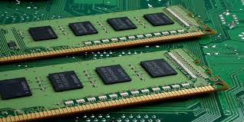
data ‘ownership’ and Land Registration
Digital succession, ‘property’, privacy
  What is a ‘digital succession’? Form (last will) and Substance (digital assets)
  Only legal rights regarding objects can be inherited by a recognised legal subject
  Property law is made more complex by succession and privacy law (‘post-mortem privacy’)
  Role of blockchain technology: last will as ‘block’, crypto-currencies, tokens
  (Proposed) legislative measures:
    a. EU: (draft report by European Law Institute)
    b. US: (Uniform Law Commission) – Uniform Electronic Wills Act and Revised Uniform Fiduciary Access to Digital Assets Act
    c. Australia (NSW) – Report by NSW Law Reform Commission

Slide 5
data ‘ownership’ and Land Registration
Tracing, access, control and passing
  Practical difficulties (private law: guardians, judicial enforcement officers, executors, notaries, land registrars)
  Tracing: How do you find digital assets?
  Access: Where, by whom and how do you get access?
  Control: You need more than the fact that there are digital assets, you need control over the content
  Passing: How do digital assets (more particularly: blockchain based) pass in case of succession?
  Should we divide a succession into a ‘traditional’ part and a ‘virtual’ part (governed by IT tools such as blockchain and smart contracts, perhaps even with a surviving subject)?

Slide 6
Digital Succession and Blockchain
Digital property: types
  Economic v. emotional value
  Importance of the carrier of data (distinguish the - physical or virtual - container from the digital content and the ‘real world object’)
  Importance of to whom the carrier belongs (private person, enterprise or government)
  Securities, cryptocurrencies, tokens, NFT’s
  Social media accounts
  Collections stored on a cloud server

Slide 7
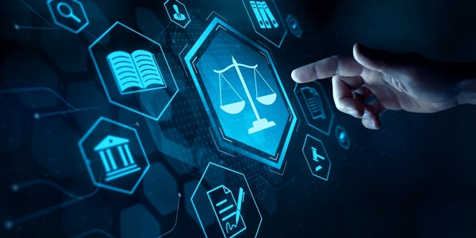
data ‘ownership’ and Land Registration
Digital property: rights
  Public law
    a. Fundamental human rights
    b. Privacy law
    c. criminal law
  Private law
    a. Contract law
    b. Property law
    c. IP law
    d. Succession law
  IT (computer code) as law

Slide 8
data ‘ownership’ and Land Registration
  Digital succession as the new frontier, also for land registration
  In succession, we have
    a physical person who passes away,
    b. leaving physical and digital assets and
    c. a virtual person who may continue
  Land, houses etc. are physical assets, but what about an accompanying ‘data passport’ (‘object wallet’) or immovable property that is ‘tokenised’? How do such digital assets pass to heirs or legatees?
  Under EU law we will all have our own digital ‘wallet’. Which land registry information will be in this wallet, and who will be entitled to it upon succession?
  How does the land registry deal with a digital last will and digital certificate of succession and solve the riddle of how the transfer of a token may (or may not) result in the transfer of the ‘real-world’ (i.e. physical) asset?
  How does the land registry accommodate a ‘digital facilitator’, especially if this is a DAO?

Slide 9
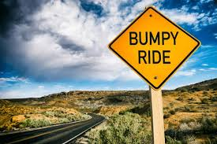
data ‘ownership’ and Land Registration
Road map towards the future: What to consider?
  Management of digital succession (including immovable property rights) by blockchain technology and smart contracts, using e-wills
  If the European Succession Certificate were in blockchain format, how would this be registered?
  If immovable property is ‘tokenised’, it should be clear
    a) who has access and control in case of, among others, succession
    b) that a distinction must be made between the ‘container’, the digital content (land registry data and data passport) and ‘real world objects’ (the physical asset), and how they are connected.

Slide 10
data ‘ownership’ and Land Registration
em. Prof. dr. J.H.M. (Sjef) van Erp
Visiting Professor Trento University
sjef.vanerp@kpnmail.nl

