Slide 1


Implementation
of EU Regulation: Succession Regulation.
ELRA Report on the EC evaluation on national requirements&reasons for rejection of application for ECS registration
ELRN Workshop
Brussels, 12th March 2025
Mhail Taus – ELRA President
Marta Rekawek – Pachwicewicz - ELRA representative
in the EC Working Group

Slide 2

EJN Working Group Succession Law
– ELRA’s Contribution
New document:
Conclusions
of the results of the survey of ELRN Contact Points on Regulation (EU) No 650/2012 of the European Parliament and of the Council of 4 July 2012 on jurisdiction, applicable law, recognition and enforcement of decisions and acceptance and enforcement of authentic instruments in matters of succession and on the creation of a European Certificate of Succession, additionally to the European Commission Questionnaire – Working Group Succession Law established at the European Judicial Network (EC). ELRA’s Working document.
Brussels, 16th December 2024

Slide 3
EJN Working Group Succession Law
– ELRA’s Contribution
ELRA's research on national requirements to register rights on real estate in a cross-border context:
detailed ELRN survey,
written responses submitted by 19 ELRN member organisations and addressed the actual state of play in a total of 18 Member States, i.e. Austria, Bulgaria, Cyprus, Estonia, Finland, Hungary, Ireland, Italy, Latvia, Lithuania, the Netherlands, Poland, Portugal, Romania, Spain, Slovakia and Sweden,
practical issue presented in Question 8.2 analysed in relation to registration practice in the Member States and the relationship between:
EU law (the Regulation) vis. national law (lex rei sitae v. lex registrationis)

Slide 4
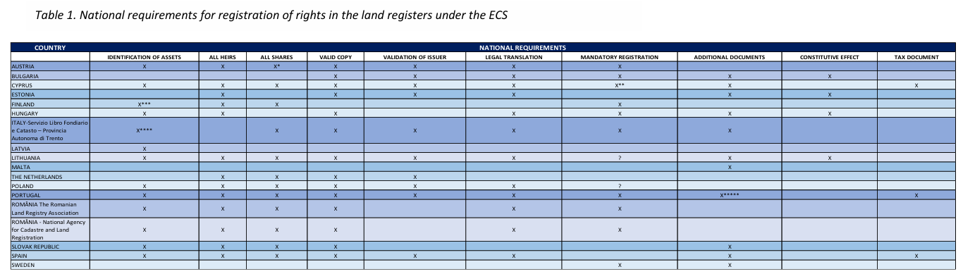
EJN Working Group Succession Law
– ELRA’s Contribution

Slide 5
EJN Working Group Succession Law
– ELRA’s Contribution
Table illustrates and gives solution:
registration requirements of each Member State
what should be included in the European Certificate of Succession in any of its part (Annex V)
the inclusion of this information should be displayed as an additional field in the ECS (Annex V), combined with the information coming from the individual national orders e.g. on the e-Justice portal or in another user-friendly form (e.g. an annex to the instructions on the form, instruction on an ECS)

Slide 6
EJN Working Group Succession Law
– ELRA’s Contribution
Practical example of ECS which would be registered in LR of Austria (1) and Poland (2):
1. Austria: it should contain information about identification of assets, identifications of all heirs, identification of shares for each heir, valid copy, validation of issuer and legal translation, but the additional issues as additional documents and tax document are not required, there is not mandatory registration and constitutive effects.
2. Poland: information about identification of assets, identifications of all heirs, identification of shares for each heir, valid copy, validation of issuer, legal translation and mandatory registration, but the additional issues as any additional documents and tax document are not required, there is no constitutive effects.

Slide 7
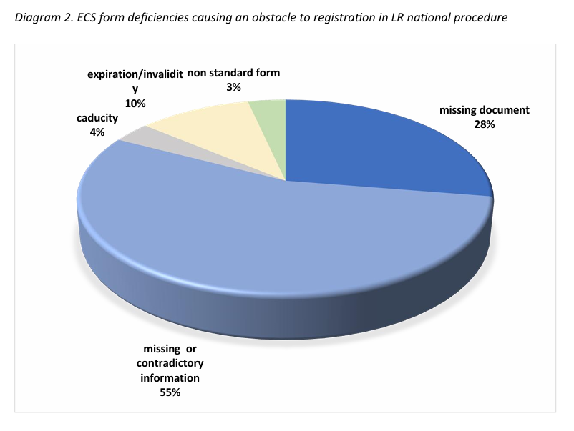
EJN Working Group Succession Law
– ELRA’s Contribution
Survay to Question 8.1 - identification the most common mistakes/ deficiencies made in applications for registration of a right in the land register using ECS as the basis for entry.

Slide 8
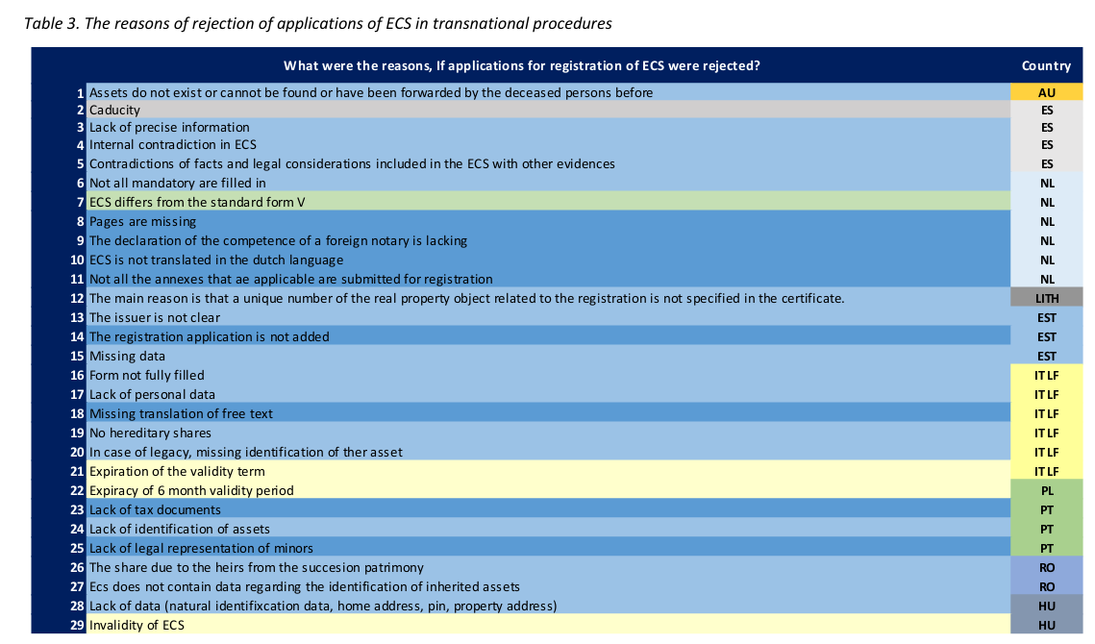
EJN Working Group Succession Law
– ELRA’s Contribution

Slide 9
EJN Working Group Succession Law
– ELRA’s Contribution
Conclusions of ELRA’s Report
the subject of the ECS and the information contained and the legal effects gives rise to it also in the sphere of registration of rights to immovable property
ECS should be explored in greater depth, in terms of both the popularity and its problematic nature
study on effect of ECS by registration would have ensured the smooth use of this instrument
it is a pity that there is not yet a central register of ECS issued
the e-Justice Portal plays a very important and positive role in this respect, but it is not always sufficient
succession law is very diverse in the EU Member States, so it is important to have a proper understanding of the type and consequences of succession actions

Slide 10
EJN Working Group Succession Law
– ELRA’s Contribution
Conclusions of ELRA’s Report
trans-national information concerning the properties, forming part of the estate should be collected, analysed and completed, what will help to prevent problems of entry in the land register
ECS plays an important role in the legal process of registering the right to real estate in the national land registers
the great diversity of national law requirements in the area of land registrations, due to different legal traditions and histories - the principle of lex rei sitae linked to the law of a particular register
it is important that the ECS captures information that considers national specificities
information from the CPs of the Member States made available on the e-Justice Portal will help issuing authorities to individualise a specific ECS across borders.

Slide 11


ANY COMMENTS /INFORMATION/ QUESTIONS?

Slide 12
THANK YOU FOR YOUR ATTENTION!

